Slide 1


TAXI FARE ANALYSIS

Slide 2


Problem Definition
Question “How Uber generates so much Revenue?”
Aim is to compare and analyze fare data of large number of trips for Taxi Companies mainly New York Yellow Cabs and Uber. Also, verify the Uber estimated fare values.
We will also try to predict the value of surcharge at a given location.
The analysis is focused on New York region only.

Slide 3

Introduction
Analyze how Uber dynamically controls its pricing using the surcharge multiplier parameter.
Uber’s on record rates shown in the App are comparable to other companies but Uber is able to make huge profits using the surcharge it applies.
Ease of Booking the Cab using the App makes the customers lured to using it and Uber takes advantage of this.
We had the dataset of NYC Cabs and we collected the data for same locations for Uber and then compared them.

Slide 4
Dataset
NYC Yellow Taxi Data(Around 143 Million Trips)
For each trip:
Pickup location(Latitude and Longitude)
Dropoff location(Latitude and Longitude)
Distance Travelled(in miles)
Duration of trip(in seconds)
Total Fare (in US Dollars)
Timezone (Range 0 to 23)(Hour Wise)
Example, Timezone 6 means time between 5:30 am to 6:30 am.
Pickup Location | Dropoff Location | Distance Travelled(miles) | Time Taken(seconds) | Total Fare (US Dollars) | Timezone
4

Slide 5
Data Generation for Uber
For initial comparison, we focused on :
Timezone 6 , 10 , 16 , 20.
The Uber Fare API does not have any time as parameter it gives the result on the basis of current time.
We are 9 hours 30 minutes ahead of New York Time.
For example, Timezone 6, from 5:30 am to 6:30 am EDT is same as
3 pm to 4 pm IST.
We picked up the popular locations from the NYC dataset for each specific timezone and threw the query to the Uber API at the appropriate time.
Uber has a lot of product services namely uberPool, uberX, uberXL, uberFAMILY, uberBLACK, uberSUV.
We will focus on UberX ( Cheapest Service of Uber)

Slide 6
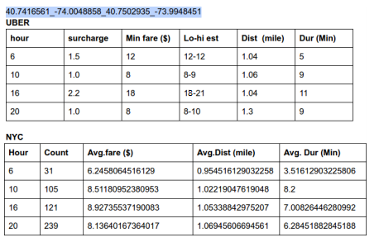
Analyze Data

Slide 7
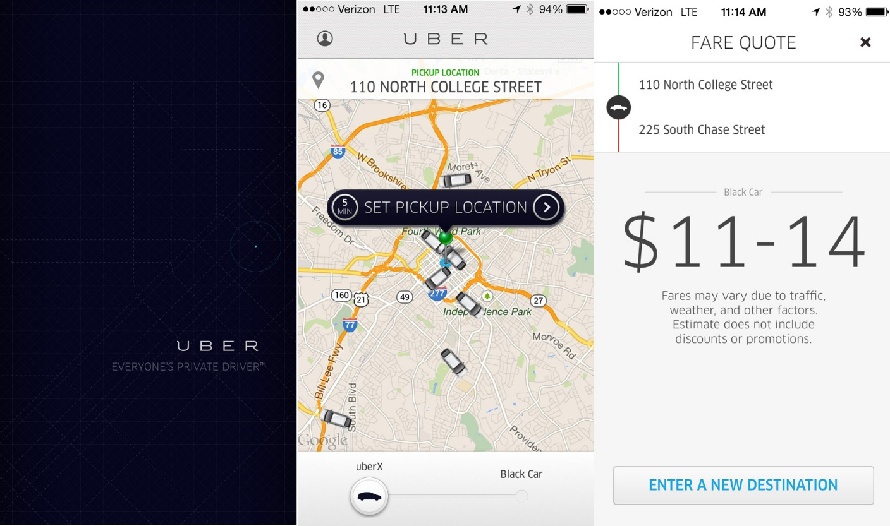
Estimated Fare

Slide 8
Low Estimate and High Estimate
We tried to fit some mathematical formulas and verified them.
For UberX , an example
Base fare: 2.55$ , price/mile = 1.75$ , price/minute = .35$ ,
Minimum Fare = 8$.
Low Estimate = Surcharge Multiplier * Minimum Fare
Low estimate = 2.2 * 8 $ = 18 $
This was verified with the data.
High Estimate = Low Estimate + Some Factor
Time factor = (Time(with traffic) - Time(without traffic)) * price/minute
Distance factor = (Distance(More maybe due to traffic) - Distance(Normal)) * price/distance
Total factor = (Time factor + Distance Factor)*surcharge mulitiplier
High Estimate = 18 + (11-7)*2.2*0.35 = 21$

Slide 9
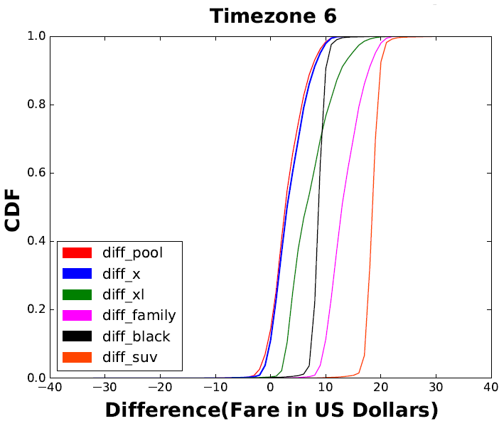
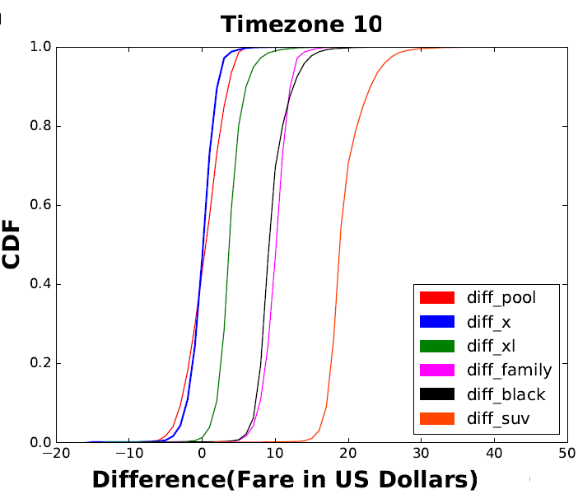
Fare Comparison (Cumulative Distribution Function)

Slide 10
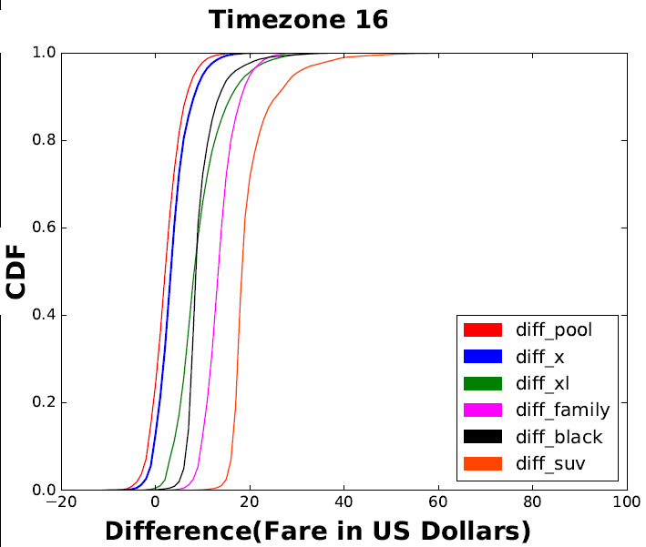
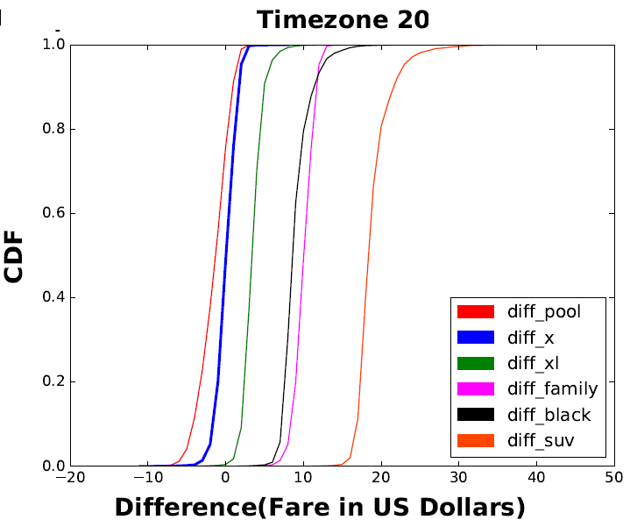

Slide 11
What do the graphs tell us ?
Looking at the blue line (Uber X):
At Timezone 6, the difference in fare is mostly greater than zero that is uber is mostly costlier.
At Timezone 10,the difference in fare is mostly zero or negative that is uber is cheaper or almost equal fare to NYC cabs. Fare decreases during the day.
At Timezone 16, the difference is fare is again mostly greater than zero that uber is costlier.
At Timezone 20, the difference is almost zero mostly, the fare decreases at night.
Above inferences tell us that uber is costly during early morning and in the evening time.
For Commuters or daily goers, uber will be costly as compared to NYC Cabs.

Slide 12
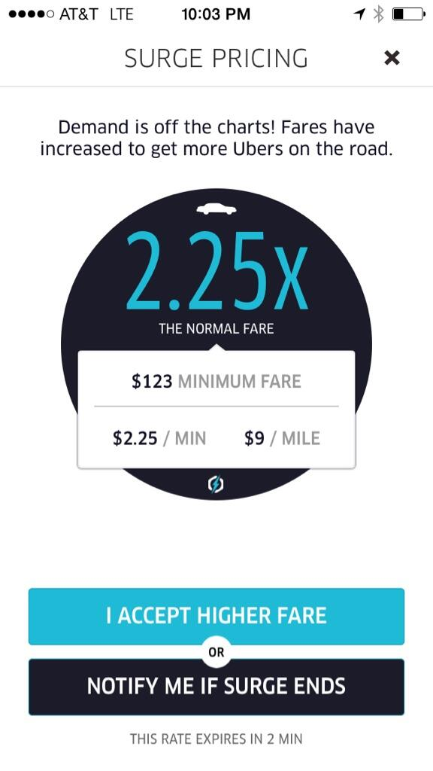
Surcharge Estimator
After doing the analysis ,we found out that uber earns most of the its money by its dynamically changing Surcharge values.
Surcharge Multiplier =
(Demand By Customers)/(Supply of Drivers).
Can we make a model that will predict the surcharge value using the data we have on giving inputs as
1. pickup location
2. dropoff location
3. timezone
4. cab service

Slide 13
Proposed Model

Slide 15
Generating the Training Set
Assuming uniform supply of drivers. Lets us suppose , surcharge only depends on the Demand or Popularity of a pickup location.
Fields:
Latitude of pickup location
Longitude of pickup location
Popularity (Counting the number of trips which started at this location in the NYC Dataset)
Average Surcharge of all the trips having this as pickup location
Pickup Latitude | Pickup Longitude | Popularity | Average Surcharge

Slide 16
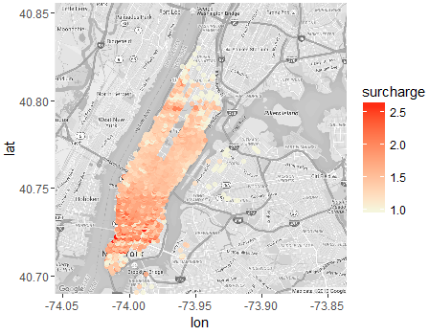
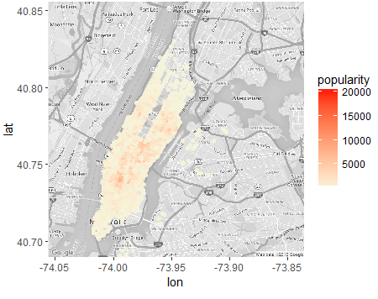
Heatmap(For timezone 16)

Slide 17
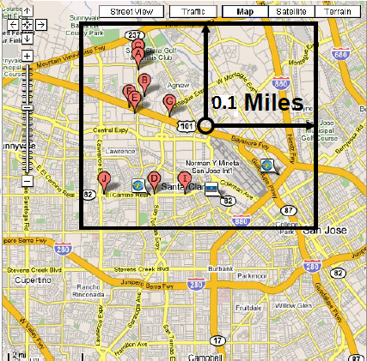
Popularity Estimator
Training Set: Pickup Location and Popularity.
Assumptions:
The demand or popularity at a location depends on it locality or near by locations.
We can only predict for a new location if it is within 1 mile radius of any of the location in the Training Set.
We start with a distance of 0.1 mile and
will go on searching upto 1 mile till we
find atleast one location.
We can take the average of demand of
all locations within the bounding box.
This method did not give us good results.

Slide 18



Improvements
Even within the bounding box , the location nearer should have more effect or more weight.
We used Inverse Distance Weighting Average(IDW) .
Distance will the great circle distance between two points.
This significantly improved our results.
R = 0.1 mile or distance within which we
are calculating.
MSE(Mean Square Error):
Timezone | 6 | 10 | 16 | 20
IDW | 0.8957 | 0.8864 | 0.06321 | 9.194

Slide 19
Surcharge Estimator
Training Set: Pickup Location, Popularity, Surcharge.
After estimating the demand at the location , we have to find the estimated surcharge at the location.
We used different regression algorithms which giving input estimated demand gave out estimated surcharge at that location at that timezone. Mean Square Error:
Timezone | 6 | 10 | 16 | 20
Linear Regression | 0.0297 | 0.0221 | 0.0422 | 0.0239
Decision Tree Regression | 0.02813 | 0.01980 | 0.04089 | 0.0231
Support vector Machine Regression | 0.02806 | 0.02850 | 0.03280 | 0.03920

Slide 20
Improvements??
Assumption , estimated value of surcharge should depend on local regions more. We can only predict for a new location if it is within 1 mile radius of any of the location in the Training Set.
We will start searching with radius of the bounding box = 0.1 mile and upto a maximum of 1 mile.
Let X0 be the popularity of the new location.
We will sort the popularities of the
neighbours and find the distance of X0,
from its neighbours.
We will use this distance for the
weight function.

Slide 21



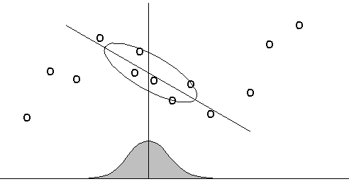

Improvements??
Inverse Distance Weighting Function
or Gaussian Function used.
After finding the weight matrix , we will this equation

Slide 22
Improved Result
Timezone | 6 | 10 | 16 | 20
Linear Regression | 0.0297 | 0.0221 | 0.0422 | 0.0239
Decision Tree Regression | 0.02813 | 0.01980 | 0.04089 | 0.0231
Support vector Machine Regression | 0.02806 | 0.02850 | 0.03280 | 0.03920
Timezone | 6 | 10 | 16 | 20
LWR | 0.0107 | 0.01092 | 0.0105 | 0.01089

Slide 23
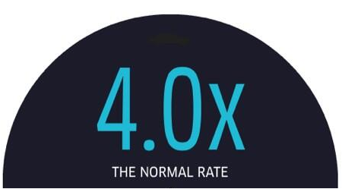

Conclusion
The proposed model estimates the average surcharge at a location with maximum Mean Square Error of 0.01 .
This model can be useful for the user, he can check the estimated surcharge for his location for any timezone and compare , analyze the change. He can plan his timings accordingly.
Next Hour

Slide 24
Future Work and Recent Changes
The model maybe extended to 24*7 hours that is can be specialized for a week instead of 24 hours only.
More better weight functions can be used.

